Slide 1

STIA1123 Programming 2
Predefined Class

Slide 2
Chapter Objectives
Learn about objects and reference variables.
Explore how to create & use object from predefined class in a program.

Slide 3
Classes and Objects
To create an object , we MUST first provide a
definition/description for it
A class is merely a template for one or more similar objects. It describes an object’s behaviour and state.
An object is created from a class. An object is called an instance of a class
Object instantiation – process of creating an object from a class.
A programmer may use predefined classes in the Java class libraries OR may define its own class
An example of common objects from predefined classes you’ll use in Java application are the String & Scanner objects
Notes:
The two most important concepts in object-oriented programming are the class and the object.
In the broadest term, an object is a thing, both tangible and intangible, which we can imagine.
A program written in object-oriented style will consist of interacting objects. For a program to maintain bank accounts for a bank, for example, we may have many Account, Customer, Transaction, and ATM objects.
An object is comprised of data and operations that manipulate these data.

Slide 4
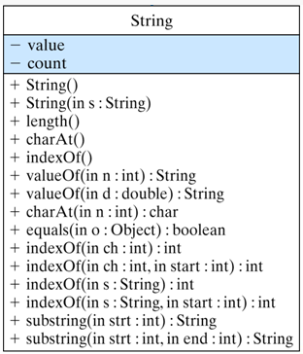
Example of Predefined Java class: The String Class
State/Data Field
Behaviour/Methods
(for complete list, refer to
API documentation)

Slide 5
Creating & Using Object
A class provides a special type of methods, known as constructors, which are used to construct and initialize objects from the class
Constructors are a special kind of methods that are invoked to construct objects
Steps to create and use objects
Declaring object reference variables
Creating object
Accessing object by invoking its method

Slide 6
Declare Object Reference Variables
To create an object, you must declare a reference variable of the object class type.
The reference variable will store the address (reference) of the object in memory.
Note: A variable holds either a primitive type or a reference to an object
A class name can be used as a type to declare an object reference variable, e.g.:
String title;
No object is created with this declaration
An object reference variable holds the address of an object
The object itself must be created separately

Slide 7
Creating Objects
Generally, we use the new operator to create an object
title = new String ("Java Software Solutions");
This calls the String constructor, which is
a special method that sets up the object
Creating an object is called instantiation
An object is an instance of a particular class

Slide 8
Java variables
Primitive type variables
Reference variables
Example:
Example:
String word;
word = new String(“Java”);
String variable word stores memory location (1234), that is the address of the memory space where actual data (Java ) is stored.
int x;
x = 45;
x
Variable x and an int value in its memory space
45
word
1234
Object word
reference variable
1234
Java

Slide 9
Creating String objects
General Syntax:
String ObjRefVar = new String(stringLiteral);
eg.
String name = new String(“Haziq”);
Since strings are used frequently, Java provides a
shorthand notation for creating a string:
String name = “Haziq”;

Slide 10
A String Object
String name;
name = new String(“Haziq”);
Haziq
length()
concat()
equals()
……
others
Object reference variable
Data of the object
name
Methods of the object
refers to object

Slide 11
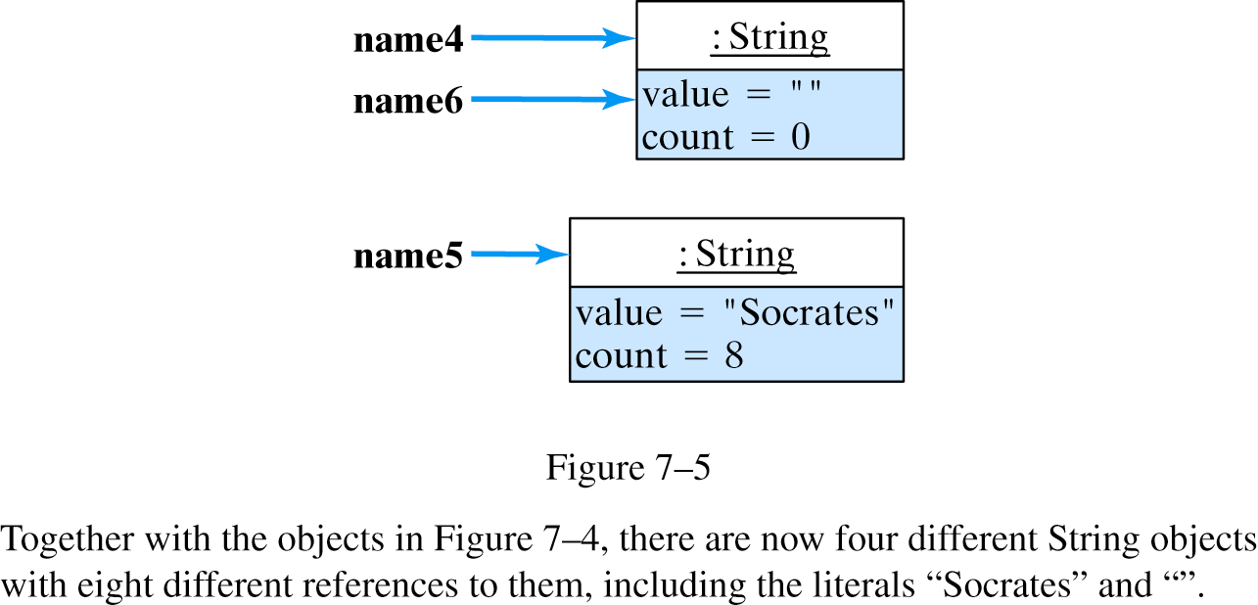
Creating String objects
Two reference variables can refer to the same object:
String name4 = new String(); // Creates an object
String name5 = new String("Socrates"); // Creates another object
String name6 = name4;

Slide 12

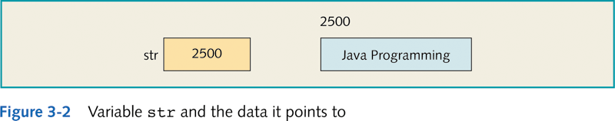
Primitive data types vs. object data types
int x; // variable of primitive data type
String str; // variable of object type
x = 45; // store the actual value
str = "Java Programming"; //store the reference to the object

Slide 13
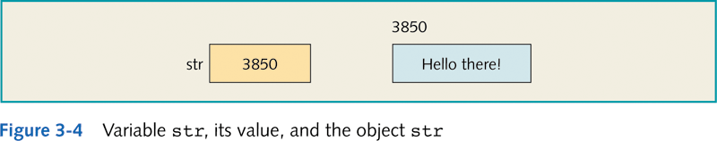
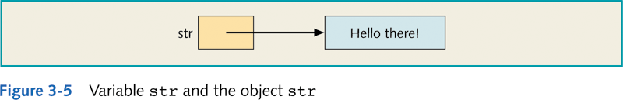
Object and Reference Variables
String str;
str = "Hello there!";

Slide 14
Questions
String stud1 = new String(“Ani”);
int studID = 65000;
What does variable stud1 contains?
What does variable studID contains?
Is this allowed? stud1 = studID;
String stud1;
stud1 = new String(“Ani”);
stud1 = new String(“Obi”);
How many objects were created by the 3 statements above?
How many reference variables are there?

Slide 15
Invoking Methods
Once an object has been instantiated, we can use the dot operator to invoke its methods
name.length()
A method may return a value, which can be used in an assignment or expression
count = name.length();
An object consists of both variables and methods. Both of these are called "members" of the object. Java uses dot operator for both.
referenceVariable.memberOfObject

Slide 16
Invoking Methods (another example)
The equals() method:
String strA; // first object
String strB; // second object
strA = new String( "The Dog" );
strB = new String( "The Dog" );
if ( strA.equals( strB ) )
System.out.println( "This WILL print.");
The equals( String ) method compares the contents of String objects. It returns either true or false.

Slide 17
Object without object reference variable
Object created with no reference variable cannot be accessed
String n1 = new String(“Ali“);
new String(“Abu“);
n1: String
: String
value = “Ali”
value = “Abu”
This object’s method can’t be invoked
n1
(n1- object reference variable)

Slide 18
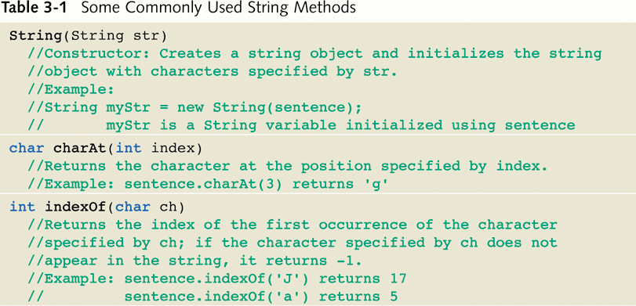
Commonly Used String Methods

Slide 19
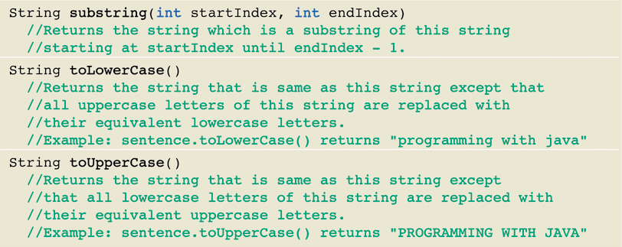
Some Commonly Used String Methods

Slide 20
public class StringExamples{
public static void main(String [] args){
String word1 = "How"; //String word1=new String ("How");
String word2 = "are"; //String word2=new String ("are");
String word3 = "you"; //String word3=new String ("you");
String word4= word1 + word2 + word3;
System.out.println("UPPERCASE: "+word1.toUpperCase());
System.out.println("word4: "+word4+"?");
System.out.println("length: "+word4.length());
System.out.println("substring: "+word4.substring(3,9));
}//end main
}//end class
UPPERCASE: HOW word4: Howareyou? length: 9 substring: areyou
OUTPUT:

Slide 21
Class Libraries
A class library is a collection of classes that we can use when developing programs
Java contains an extensive library of pre-defined classes
The Java standard class library is part of any Java development environment
Its classes are not part of the Java language per se, but we rely on them heavily
Various classes we've already used (System , Scanner, String) are part of the Java standard class library
Other class libraries can be obtained through third party vendors, or you can create them yourself

Slide 22
Class Libraries
These classes are divided into groups called packages.
Package: Contains several related classes
Class: Contains several methods
Method: Set of instructions

Slide 23
Packages
The classes of the Java standard class library are organized into packages
Some of the packages in the standard class library are:
Package
java.lang
java.applet
java.awt
javax.swing
java.net
java.util
javax.xml.parsers
Purpose
General support
Creating applets for the web
Graphics and graphical user interfaces
Additional graphics capabilities
Network communication
Utilities
XML document processing

Slide 24
The import Declaration
When you want to use a class from a package, you could use its fully qualified name
java.util.Scanner
Or you can import the class, and then use just the class name
import java.util.Scanner;
To import all classes in a particular package, you can use the * wildcard character
import java.util.*;

Slide 25
The import Declaration
All classes of the java.lang package are imported automatically into all programs
It's as if all programs contain the following line:
import java.lang.*;
That's why we didn't have to import the System or String classes explicitly in earlier programs
The Scanner class, on the other hand, is part of the java.util package, and therefore must be imported

Slide 26
The Random Class
The Random class is part of the java.util package
It provides methods that generate pseudorandom numbers
A Random object performs complicated calculations based on a seed value to produce a stream of seemingly random values

Slide 27
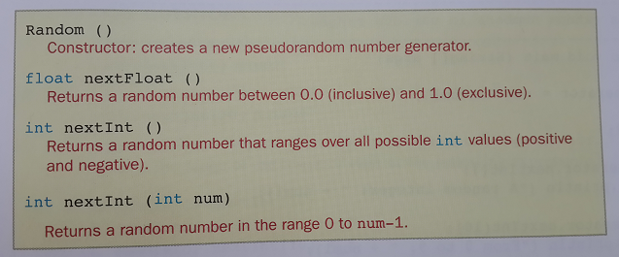
The Random Class
Some methods of the Random Class

Slide 28
The Random Class
import java.util.Random;
/* Create a random number that is greater than or equal to 0,
and less than 100. (It is set to run 20 tests.)*/
public class JavaRandomClassExample {
public static void main(String[] args){
int numTests = 20; // run 20 random examples
Random random = new Random();// create a new Java Random object
for ( int i=0; i<numTests; i++ ){
int randomInt = random.nextInt(100); // get the next random int
System.out.print(randomInt +" ");
}
}
}
Sample output:
27 43 22 0 86 60 27 90 11 30 54 68 70 73 58 0 12 79 37 10

Slide 29
Chapter Summary
Primitive type variables store data into their memory space.
Reference variables store the address of the object containing the data.
An object is an instance of a class.
Operator new is used to instantiate an object.

Slide 30
Chapter Summary
To use a predefined method, you must know its name and the class and package it belongs to.
The dot (.) operator is used to access a certain method in a class.
Methods of the class String are used to manipulate input and output data.
Random class provides methods that generate pseudorandom numbers

